Slide 1




Automatic Attendance Monitoring System using AI
201CS118 - ARUN K
201CS117 - ANUPRAKASH S
201CS221 - MUHAMMED THAHA A I

Slide 2
Abstract
E-learning has emerged and helped students to learn and contribute towards their academics in an easier way. Online platforms like Google meet, Zoom, Microsoft teams have been used by many of the students and their universities. Though it helped a lot for students. But students of the schools and universities have been instructed to turn off their camera and microphone during the online classes. There are some drawbacks that reduce the quality of education on online platforms. In offline mode we can monitor the students easily. But in online mode we cannot assure that students are attentive and listening to the teachers’ words even though they have joined the meeting.
The solution for the problem can be obtained by introducing a new software that takes automatic attendance through the camera several times and by recognition of the student face to the registered face. There will not be any specific time for the attendance and the camera will be turned on at random intervals of time. So, the student will be more attentive in the class. The faces of the student will be pre registered in the school’s database and while this attendance progresses the AI records the student face and machine compares the face of the student to his/her registered face in the database. If both the faces match then it marks the attendance as present. If the student is not present over the class, then the AI also notifies the respective teacher and also the parents of the student.

Slide 3
Problem statement
In offline mode we can monitor the students easily. But in online mode we cannot assure that students are attentive and listening to the teachers’ words even though they have joined the meeting.

Slide 4
Current solution
In current scenario attendance is taken via google forms or through calling the names of the students but it is not a effective solution since most of the students do malpractice by sending the google forms to their friends and they may not be attentive
And there are many loopholes.

Slide 5
Proposed solution
The solution for the problem can be obtained by introducing a new software that takes automatic attendance through the camera several times and by recognition of the student face to the registered face. One of the advantages is that students must be present throughout the class otherwise the respective student will be marked as absent. There will not be any specific time for the attendance and the camera will be turned on at random intervals of time. So, the student will be more attentive in the class. The faces of the student will be pre registered in the school’s database and while this attendance progresses the AI records the student face and machine compares the face of the student to his/her registered face in the database. If both the faces match then it marks the attendance as present. If the student is not present over the class, then the AI also notifies the respective teacher and also the parents of the student.

Slide 6
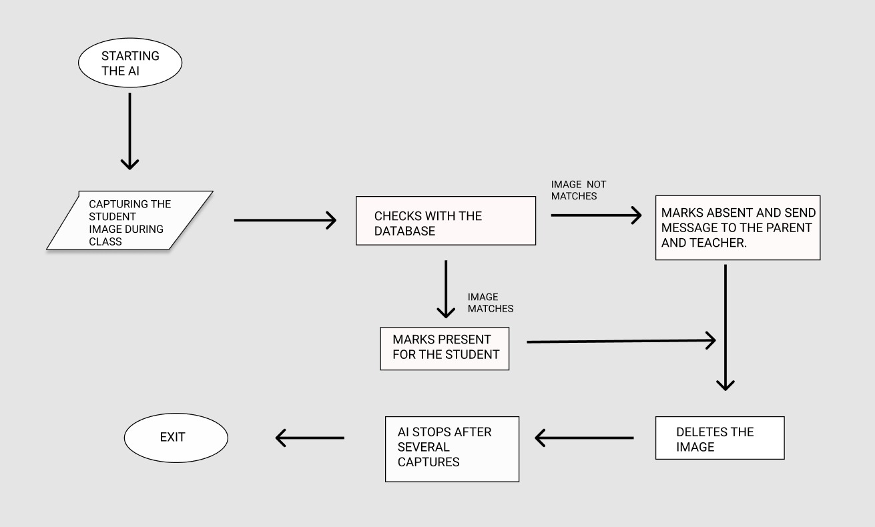
Flowchart:

Slide 7
Technology used
Using the most preferable technology for this attendance monitoring system is important.
Facial recognition is technology used to identify the images of human faces and match with the
A facial recognition system is a technology capable of matching a human face from a digital image or a video frame against a database of faces, typically employed to authenticate users through ID verification services, works by pinpointing and measuring facial features from a given image.
Facial recognition is the way of identifying or conforming an individual's identity using their face .Facial recognition systems can be used to identify the people in photo,videos or real time.It is a category used in photos, videos, or in real-time. Facial recognition is a category of biometric security. It is used in all kinds of industries and also in the major working places.This face recognition system is mainly used for mask detection in this pandemic and also to manage the attendance in large scale industries .

Slide 8
Working
Face recognition is used in daily life for example every one of us use face unlock for their privacy.Face recognition technology is used by each and every individual in their day today life with the help of their camera in their mobile phones to unlock their device . Typically face recognition does not depend on a massive database to unlock our mobile phones ,it simply identifies and recognizes one or two individuals depending on the user's wish.The process of unlocking phones using this technology works by matching the faces of people that are in front of the camera with the pre registered image in the database.If both the faces matches then the device unlock. The faces need not to be more accurate, it can be precise.But the face of the person must be the same .

Slide 9
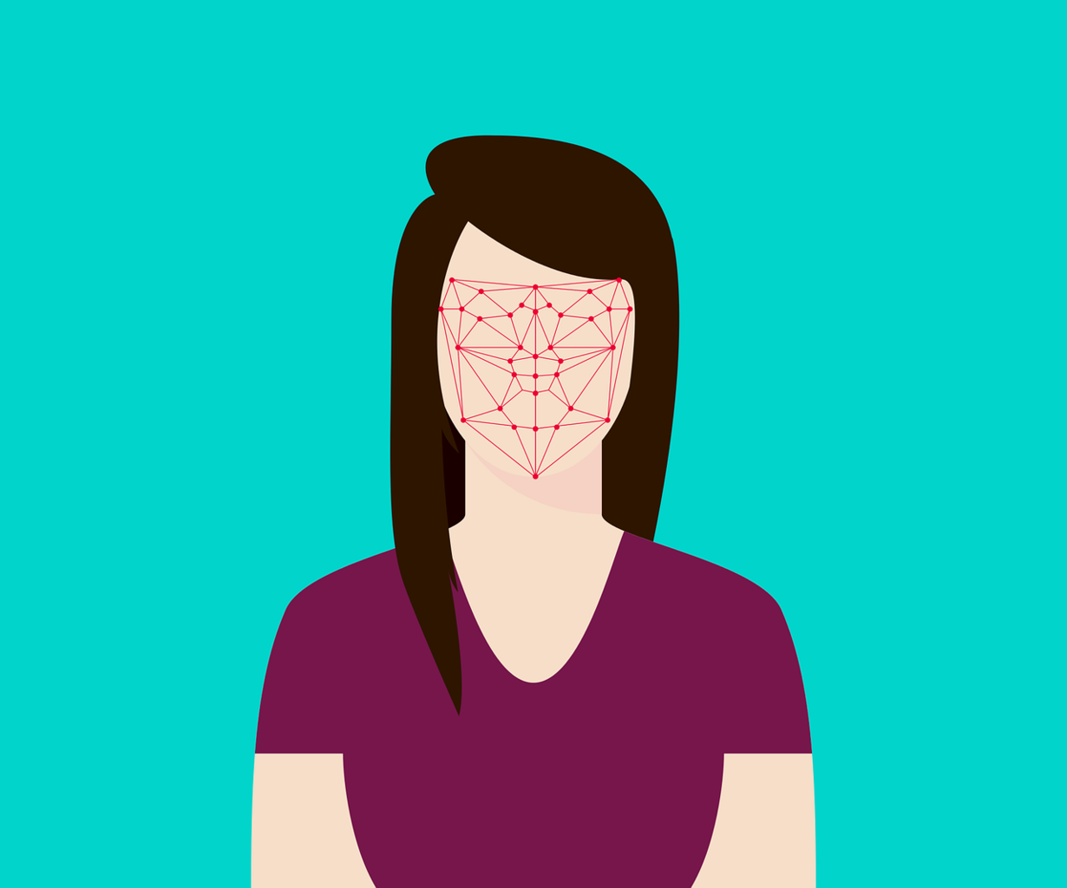
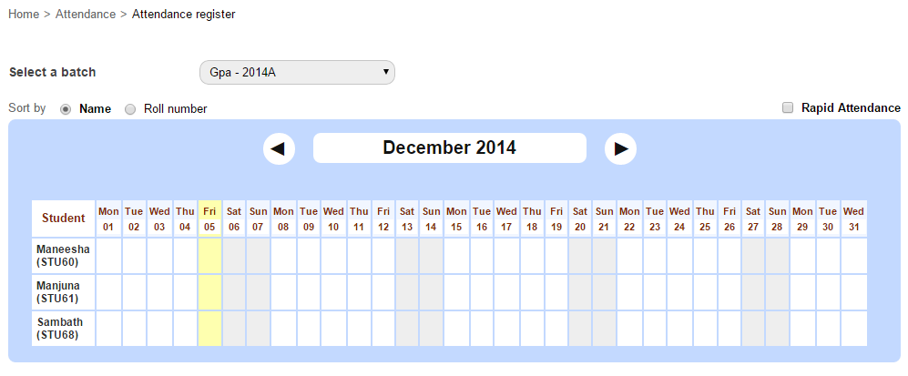
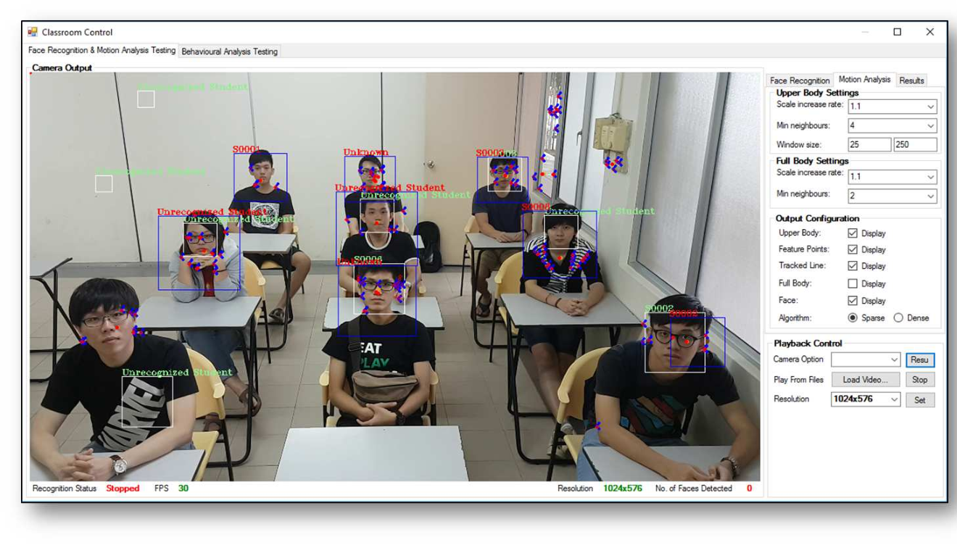
Sample output

Slide 10
References
[1] H. Kopetz, “Internet of things,” in Real-time systems. Springer, 2011, pp. 307–323.
[2] R. H. Weber and R. Weber, Internet of things. Springer, 2010, vol. 12.
[3] R. Brunelli and T. Poggio, “Face recognition: Features versus templates,” IEEE transactions on pattern analysis and machine intelligence, vol. 15, no. 10, pp. 1042–1052, 1993.
[4] K.-C. Lee, J. Ho, and D. J. Kriegman, “Acquiring linear subspaces for face recognition under variable lighting,” IEEE Transactions on pattern analysis and machine intelligence, vol. 27, no.
[5], pp. 684–698, 2005. [5] M. A. Turk and A. P. Pentland, “Face recognition using eigenfaces,” in Computer Vision and Pattern Recognition, 1991. Proceedings CVPR 91., IEEE Computer Society Conference on. IEEE, 1991, pp. 586–591.

